Slide 1
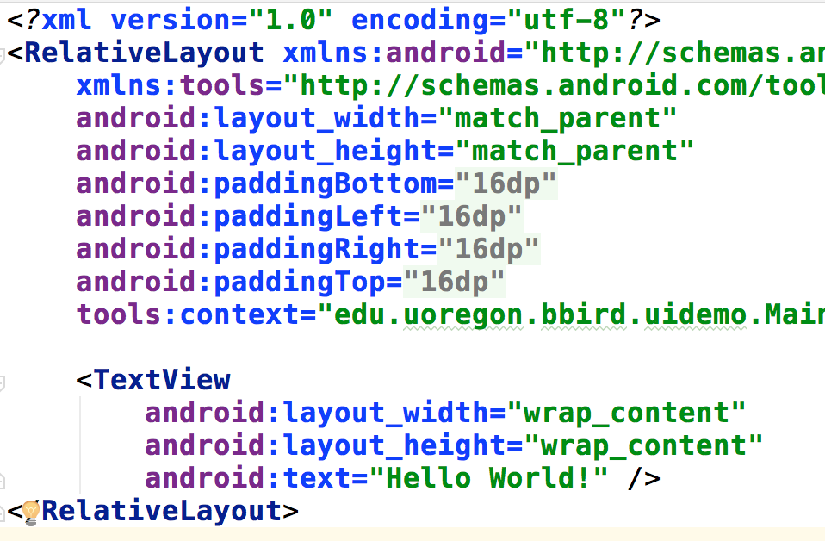
Layouts and Widgets
CIS 399

Slide 2
Course Overview
Wk | Topic
1 | Intro + single-screen apps
1 | Activity Lifecycle +
1 | Saving activity state and more
2 | Layouts + Widgets
2 | Menus + Themes
2 | Multi-screen apps + Fragments
Wk | Topic
3 | Reading XML files + Asynch Tasks
3 | List Views
3 | SQLite Database
4 | Consuming a web service
4 | Geolocation

Slide 4
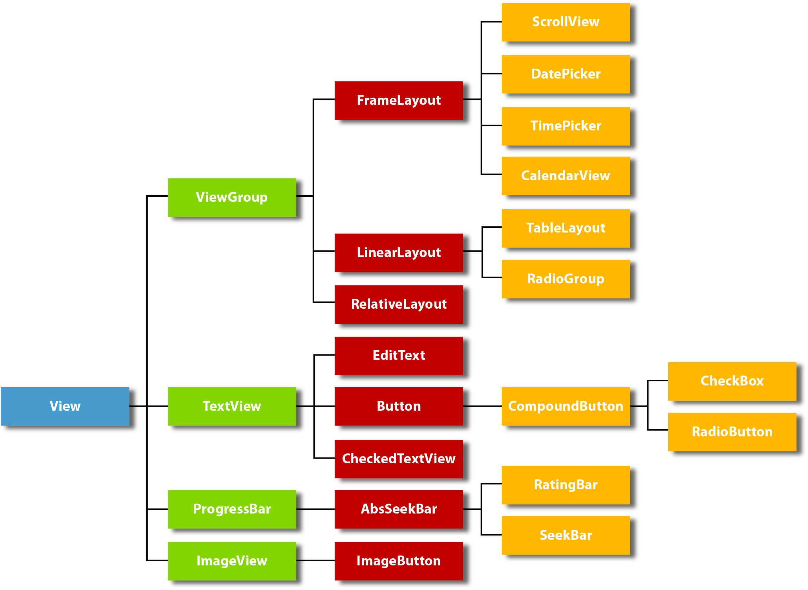

Slide 5




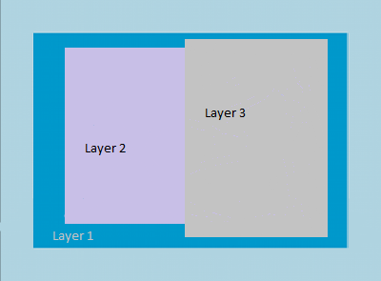
Layouts

Slide 6
Linear Layout
Notes:
https://developer.android.com/reference/android/widget/LinearLayout.html

Slide 7
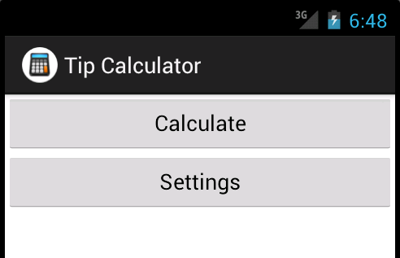

Slide 10
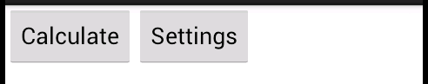

Slide 11
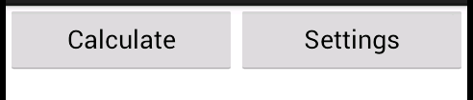
weight attribute for both buttons: android:layout_weight="1"
Notes:
Note the difference between layout_weight and weight
https://developer.android.com/reference/android/widget/LinearLayout.LayoutParams.html#attr_android:layout_weight

Slide 12
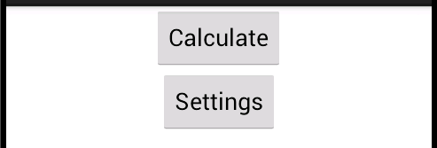
Note: this is an attribute of the LinearLayout, not the Button
Notes:
See the next slide for the difference between layout_gravity and gravity.

Slide 13
gravity vs. layout_gravity
gravity attribute
Determines how the items contained by this item will be positioned.
https://developer.android.com/reference/android/widget/LinearLayout.html#attr_android:gravity
layout_gravity attribute
Tells it’s parent how this item should be positioned.
https://developer.android.com/reference/android/widget/LinearLayout.LayoutParams.html#attr_android:layout_gravity

Slide 14
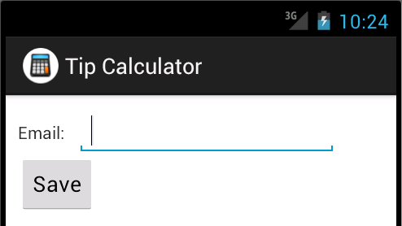

Slide 17
Table Layout

Slide 18
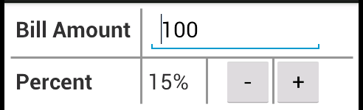

Slide 21
Frame Layout

Slide 22
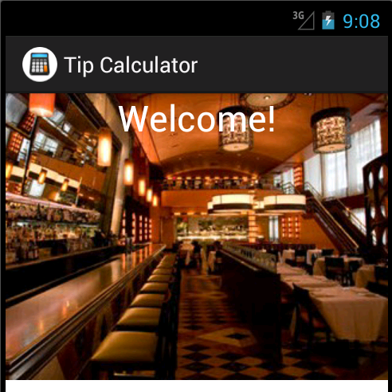

Slide 24
Changing Layouts with Orientation

Slide 25
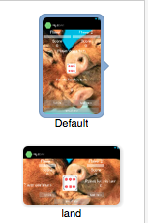
Folder Names Identify the Layout
Portrait
Default orientation
Folder name: layout or layout-port
Landscape
Folder name: layout-land

Slide 26
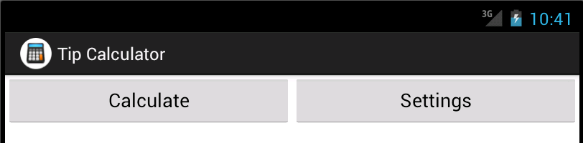

Slide 28
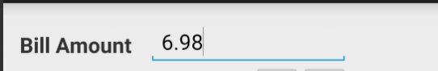
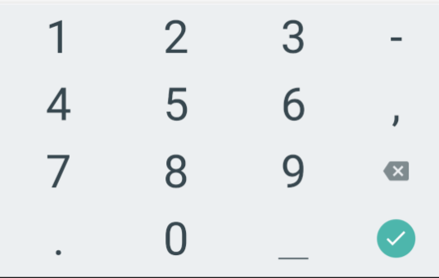
EditText Input Types

Slide 29
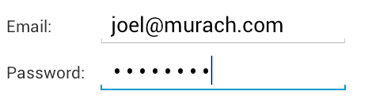

Slide 33
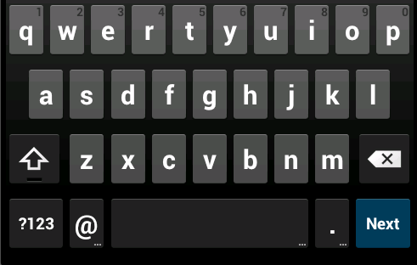

Slide 35
Widgets
widget
[wij-it]
noun
A small mechanical device, as a knob or switch, especially one whose name is not known or cannot be recalled; a gadget.

Slide 37

Check Box

Slide 40

Radio Buttons

Slide 41
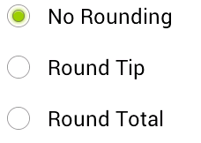

Slide 45

Spinners

Slide 46
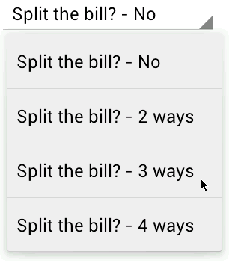
Notes:
A Spinner is used to produce a drop-down list

Slide 51
Spinner Code Tour
Open the solution to Exercise 5-2 in Android Studio and look at it.
Find the Spinner element in the AXML layout.
Find the places it is used in TipCalculatorActivity.java
splitSpinner is a field of the class
onCreate: what happens here?
How is the ArrayAdapter involved?
find the split_array in strings.xml. How is this used?

Slide 52
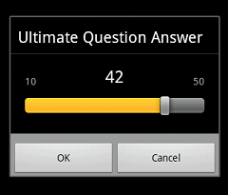
Seek Bar

Slide 54
Notes:
Note that this widget can be used both for input and output

Slide 55
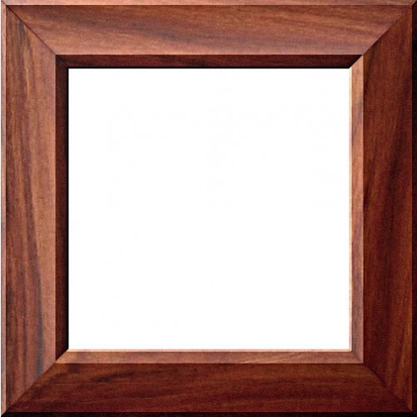

Images

Slide 56
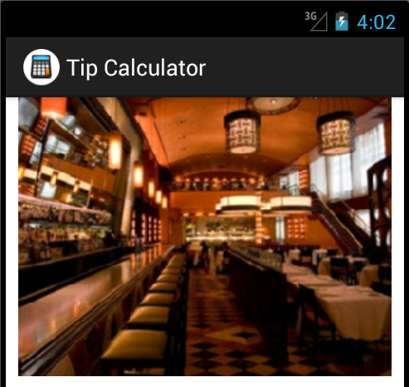

Slide 58
Notes:
When you refer to the image in AXML or Java, you just refer to it by name and the correct density version will be used.

Slide 59

Misc. UI Topics

Slide 60
Notes:
https://developer.android.com/training/accessibility/accessible-app.html
android:contentDescription provides a description for users who can’t see the screen well. It can be used by a service like TalkBack that reads the screen.
https://play.google.com/store/apps/details?id=com.google.android.marvin.talkback

Slide 61
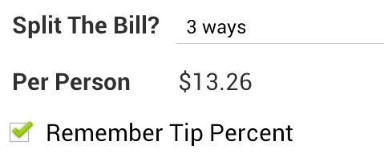
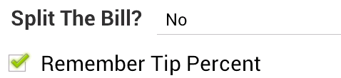

Slide 62
Notes:
Note the difference between disabled, INVISIBLE and GONE

Slide 63
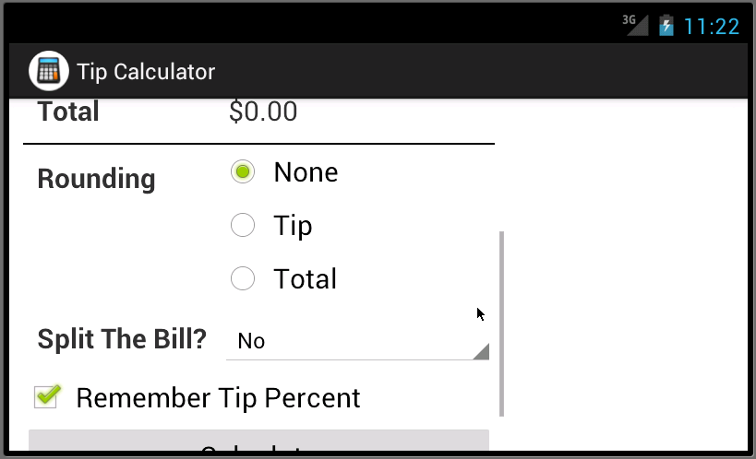

Slide 66
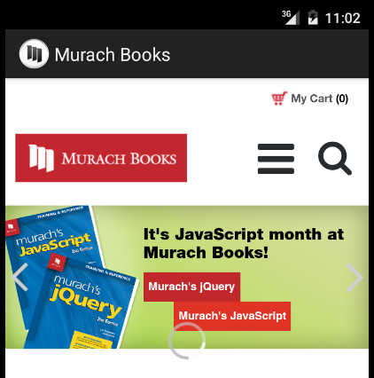
A web view

Slide 67
Notes:
Configuration changes are automatically handled by the activity so that the web page isn’t re-loaded every time there is a configuration change.

Slide 68
Notes:
Since this is a FrameLayout, the progress bar will be loaded in a layer on top of the WebView

Slide 69
Notes:
On the following slide you will see that the progress bar is only visible when the page is loading.

Slide 70
Notes:
Note that the progress bar is hidden when the page has loaded.

